Slide 1


Magento 2 Overview
Alan Kent
Magento Chief Architect

Slide 2

Magento 2 Timeline & Goals
Notes:
A lot has changed in terms of web development since the release of Magento 1. We will start by ensuring Magento 2 is built using the latest technologies and standards, to allow developers to take advantage of the latest development standards and features
We have heard loud and clear that performance and scalability are needed to allow merchants to continue to grow on Magento. Magento 2 will also offer customers better performance and scalability. And, developers will be able to measure this improvement using a new benchmarking framework we will make available

Slide 3
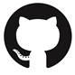
Release Approach
WE WANT FEEDBACK!
2014
2015
2016
2017
2.0
Dev Beta
2.0
Merchant Beta
2.x
Ongoing Releases
2.0
Dev RC
2.0
Merchant GA
magento/magento2
(weekly code pushes)

Slide 4
Product and Software Versions
Verticals?
(Fashion & Apparel)
CE
EE
2.0 2.1 2.2
2.0 2.1 2.2
1.0 1.1 2.0
Products
Modules
Cart
Sales
Catalog
10.0.0 10.0.1 10.1.0
10.0.0 11.0.0 12.0.0
10.0.0 10.1.0 10.2.0
? = 10

Slide 5







MAGENTO 2: PLATFORM GOALS
Modern tech stack
Simplify external integrations
Improved performance
& scalability
M2
Easier installation
& upgrades
Streamline customizations
High code quality & testing

Slide 6
Modern Tech Stack
Notes:
A lot has changed in terms of web development since the release of Magento 1. We will start by ensuring Magento 2 is built using the latest technologies and standards, to allow developers to take advantage of the latest development standards and features
We have heard loud and clear that performance and scalability are needed to allow merchants to continue to grow on Magento. Magento 2 will also offer customers better performance and scalability. And, developers will be able to measure this improvement using a new benchmarking framework we will make available

Slide 7
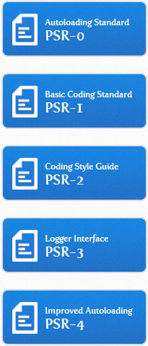






Tech Stack

Slide 8






Integration

Slide 9
Improved performance & scalability
Notes:
A lot has changed in terms of web development since the release of Magento 1. We will start by ensuring Magento 2 is built using the latest technologies and standards, to allow developers to take advantage of the latest development standards and features
We have heard loud and clear that performance and scalability are needed to allow merchants to continue to grow on Magento. Magento 2 will also offer customers better performance and scalability. And, developers will be able to measure this improvement using a new benchmarking framework we will make available

Slide 10
Page Caching
CE Full Page Caching
Built-in: Filesystem/Redis
External: Varnish
Private/public content
Cache invalidation logic

Slide 11

Page Caching Indexing
Refactored: Catalog, Price, EAV, Stock, URL Rewrite, …
Partial indexing
Work in background
No manual re-indexing
Materialized View (Mview)

Slide 12

Page Caching Indexing Perf Toolkit
Standard toolkit for measuring performance
Benchmarking key flows
M2 performance analysis kicking off in earnest

Slide 13

Page Caching Indexing Perf Toolkit Scalability
Making it easier to scale
Blueprints for successful scaling strategies

Slide 14










Docker and Simplifying Cloud Scalability
NEW
“Docker - An open platform for distributed applications for developers and sysadmins”
Public collaborative project (GitHub) to define standard recommended Docker images
Each server registers itself in etcd
Each server watches other clusters for changes in membership
Reverse Proxy
CDN
Varnish
ETCD
…
Varnish fan out
Payment Gateway
Job Server
Apache2
Admin
Store Front
PURGE requests
…
https://hub.docker.com/u/alankent/
27 Magento images from 19 community members already on public Docker repository
MySQL
SOLR
REDIS
Master
Replica
Replica
…
R/W
RO
…
RO
…

Slide 15
Streamline customizations
Notes:
Magento is valued for being easily customized. We are going to make customizations even easier by making the code more modular and allowing developers to make finer grain changes that don’t impact other areas of the code.
Frontend development is also going to be more efficient because we are separating business logic from the presentation layer, reducing the need to cut, copy and paste code by 80%, and adding a CSS preprocessor. This will speed and simplify coding, and open Magento Frontend development up to a wider group of developers, giving merchants greater choice.
Magento 2 enhances our APIs so it will be easier to extend core functionality. APIs are progressing in two important ways. First, API coverage is increasing to cover more actions (See if we can quantify this), so you can do more via APIs. Second, the new APIs will be more efficient, so that you need to make fewer calls to get the information you need.

Slide 16

Dependency Injection
Encourages loose code coupling

Slide 17
Mage Class
God Class “Mage::” is eliminated
Mage::getModel('Magento_Customer_Model_Address')

Slide 18

Interceptors & Plugins
Before method
After method
Around method
Sorting

Slide 19
Magento Framework
All framework code in one namespace

Slide 20
Modularity
View
App
Admin
Framework/ View
Layout Infrastructure
Block Rendering
Template Engine
Framework/ App
Routers
Front Controller
Boot-strapping
Request/ Response
Magento/ Adminhtml
Catalog/ Adminhtml
Customer/ Adminhtml
*{Module}/ Adminhtml

Slide 21

Modularity
Product: optional product types
Catalog: new modules, delete from code
Sales: extracted Recurring Payment
Shipping: carrier, decoupled shipping methods
Checkout: extracted Term&Conditions, multishipping
Payments: offline payment, decoupling payment methods

Slide 22

Price Logic
Price logic decomposition per price type
Price Interfaces
Price decoupled from Tax and Weee
Price “adjustment”

Slide 23

i18n
Global function __()
Phrase
RendererInterface
Composite, Inline, Placeholder, Translate
[Module]/i18n

Slide 24
Layouts
Layouts, templates (view) in Modules
Layout file responsible only for single page/block
Validation Layout XML (XML Schema)
Extend Layout
Merging Layouts
Override Layout
Page Types

Slide 25

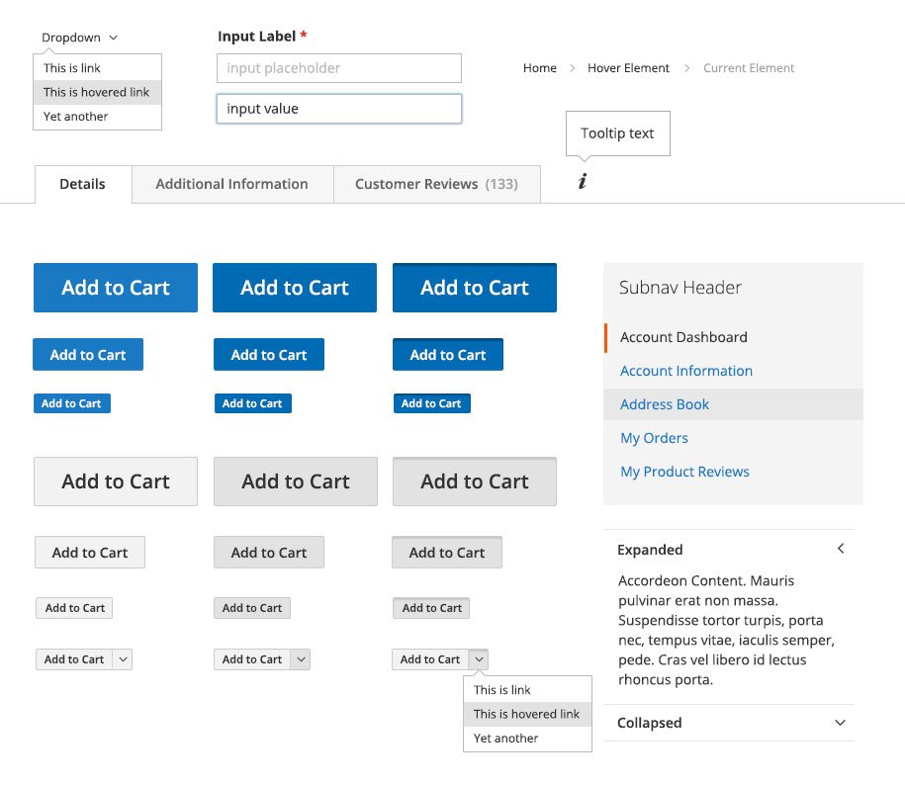
Magento UI Library
Upgradability
Consistency
Reusable Magento UI components
Styling and design best practices
Good documentation
Simplifies customization
Notes:
A lot of efforts we have focused to build the Magento UI Library, which represents by itself the extensive list of reusable UI components, with styling and design best practices from Magento UI team.
Why it matters?
First, it makes the customization process easier, since you can find the well described, extendable, ready to be used to create custom themes of any complexity
Apply them consistenly across the entire store front. Previously, it took <20> lines of code to change the button’s color, while now it just very simple action.
For the business side, it gives the ability to easier upgrade to the newest Magento versions, since you don’t need to write a lot of your own code.
And we know that Magento Developers wanted us to provide extensive documentation of magento capabilities, so here you have it.

Slide 26

Blank Theme
Mobile First Responsive Design

Slide 27
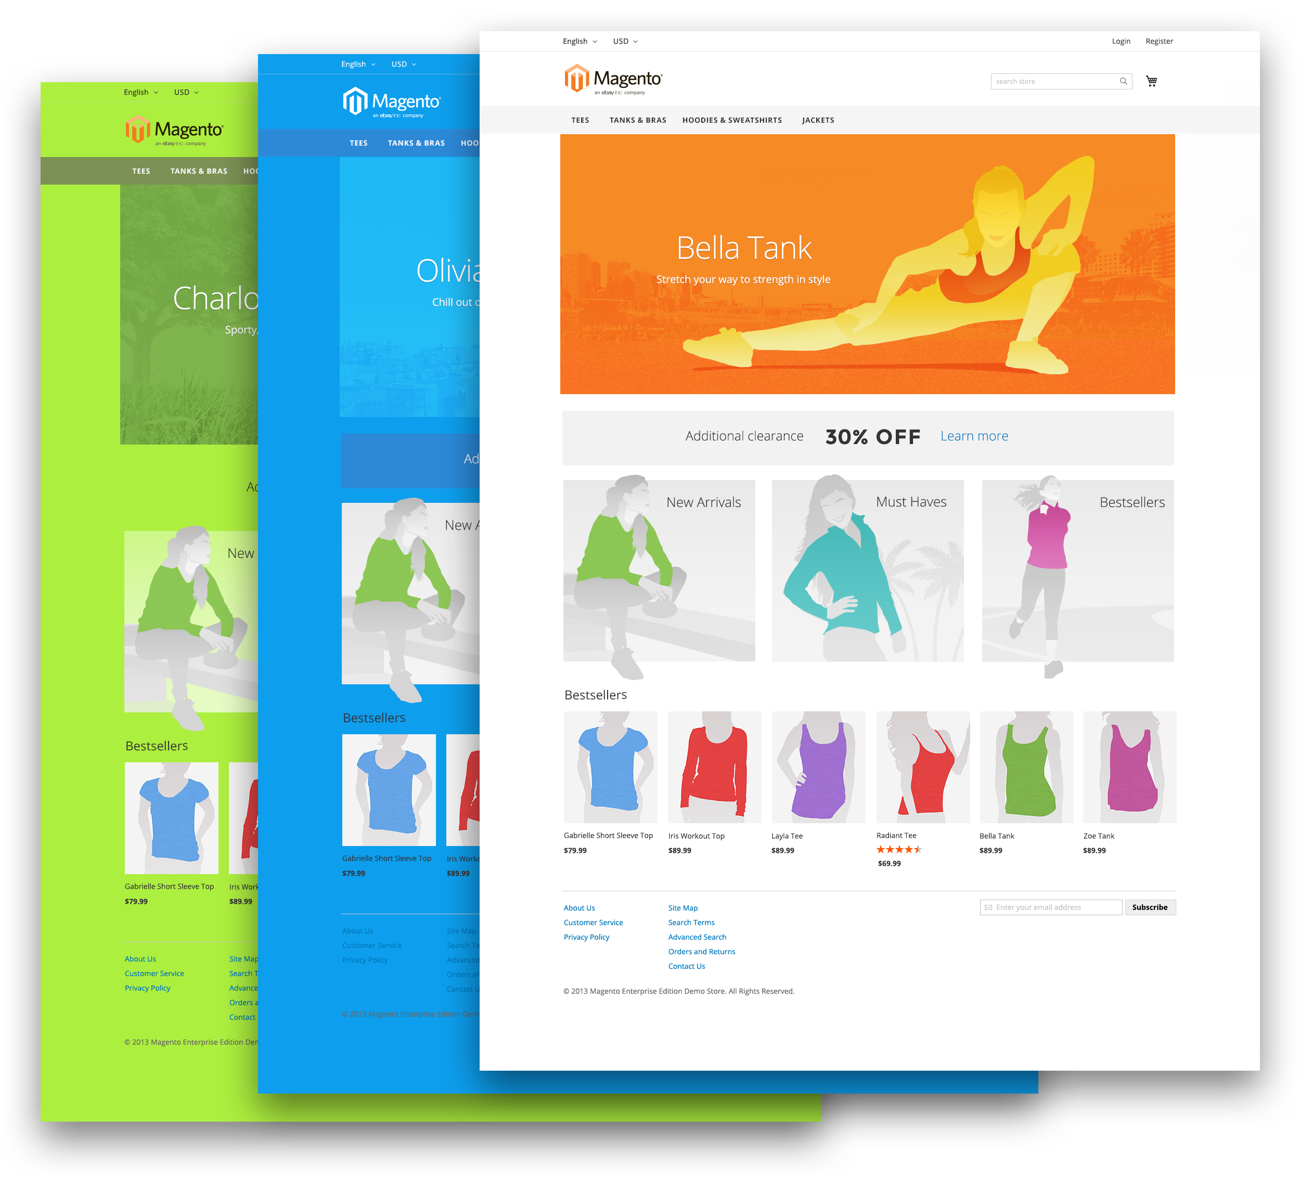
Multilevel Theme Inheritance
Simplifies customization
Flexible store design
Allows store to be special
Maintainability
Less code duplication
Notes:
We know that each merchant has a need to update the store design to the holidays, seasons or by a lot of other reasons.
But once you’ve created the amazing design once, you want to reuse those best-practices for all other design changes and improve it.
So in Magento2 we have improved multilevel theme inheritance,
Which makes you store special by allowing to change everything on your store front.
Gives you amazing design flexibility, so now your marketing and design departments can enjoy a full variety of your store designs.
For developers who makes this magic, we focused on simplification of this customizations. So usage of theme inheritance in your store, gives you better maintainability and reduces the code duplication.

Slide 28
Simplify external integrations
Notes:
Magento is valued for being easily customized. We are going to make customizations even easier by making the code more modular and allowing developers to make finer grain changes that don’t impact other areas of the code.
Frontend development is also going to be more efficient because we are separating business logic from the presentation layer, reducing the need to cut, copy and paste code by 80%, and adding a CSS preprocessor. This will speed and simplify coding, and open Magento Frontend development up to a wider group of developers, giving merchants greater choice.
Magento 2 enhances our APIs so it will be easier to extend core functionality. APIs are progressing in two important ways. First, API coverage is increasing to cover more actions (See if we can quantify this), so you can do more via APIs. Second, the new APIs will be more efficient, so that you need to make fewer calls to get the information you need.

Slide 29
Service Layer and Web API
Consistent, versioned PHP & Web Service API
REST & SOAP
Evolution strategy
Super-glued: No restriction of what is called
Tightly coupled: Restricts calls to “stable” API
Loosely coupled: Restricts access to interface based API (allows service replacement)

Slide 30
Side Benefit of Web Services: Exposing the Magento Schema
Customer Account
Cart Repository
Services
Customer
Customer Group
Cart
Addresses
Address
Totals
Cart Item
Data Model
Region
Region
Total Item

Slide 31
Easier installation & upgrades
Notes:
We are also going to improve the way you set up, upgrade, and extend Magento. A standalone installer will make it straightforward and faster to install a new Magneto instance, and scripts will highlight potential code conflicts BEFORE you upgrade to the next version or add a new extension.
And, we are actively working to make the upgrade to Magento 2 easier by allowing you to import your existing customer records, product catalog, and config settings to Magento 2.
Finally, we are committed to maintaining a high quality platform with this new release, and will be providing you with a full testing framework to help speed your development and QA process. We will also be providing you with significantly more documentation than ever before to help you ramp up quickly.

Slide 32
Composer and Deployment Tool
Command line for advanced users
Web based for simpler use cases
Modules, extensions, faster patches
magento/magento-composer-installer

Slide 33
High code quality & testing
Notes:
We are also going to improve the way you set up, upgrade, and extend Magento. A standalone installer will make it straightforward and faster to install a new Magneto instance, and scripts will highlight potential code conflicts BEFORE you upgrade to the next version or add a new extension.
And, we are actively working to make the upgrade to Magento 2 easier by allowing you to import your existing customer records, product catalog, and config settings to Magento 2.
Finally, we are committed to maintaining a high quality platform with this new release, and will be providing you with a full testing framework to help speed your development and QA process. We will also be providing you with significantly more documentation than ever before to help you ramp up quickly.

Slide 34


Test Automation
Full set of tests: Unit, Integration, Static, Legacy
Functional Test – Magento Testing Framework (MTF)
Continuous Integration & Continuous Delivery
Performance Testing
Regression Testing
magento/mtf

Slide 35
Conclusions
Notes:
A lot has changed in terms of web development since the release of Magento 1. We will start by ensuring Magento 2 is built using the latest technologies and standards, to allow developers to take advantage of the latest development standards and features
We have heard loud and clear that performance and scalability are needed to allow merchants to continue to grow on Magento. Magento 2 will also offer customers better performance and scalability. And, developers will be able to measure this improvement using a new benchmarking framework we will make available

Slide 36
In a Nutshell
On track time-wise
Upgrade of tech stack
Decoupling and cleaning up the code base
Controlling cross module dependencies better
Marching towards full test automation

Slide 37



Thank You!
@akent99
https://github.com/alankent
http://alankent.wordpress.com/
https://registry.hub.docker.com/repos/alankent/

